Slide 1

Report Reproducibly with
Slides CC BY-SA RStudio

Slide 2

Navigate to the 06-Report folder. Open 06-Report-Exercises.Rmd
2

Slide 3


R Markdown

Slide 4
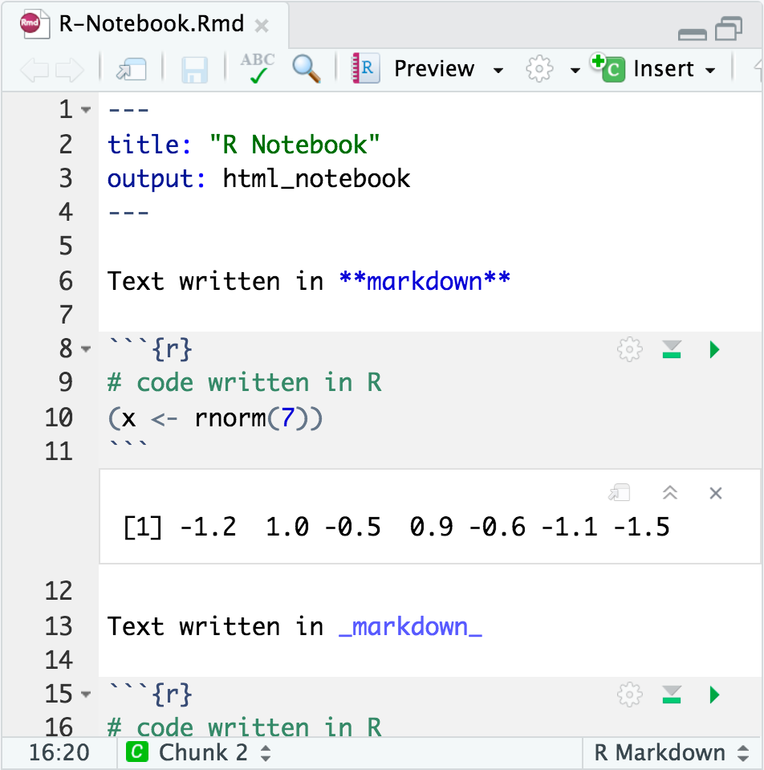

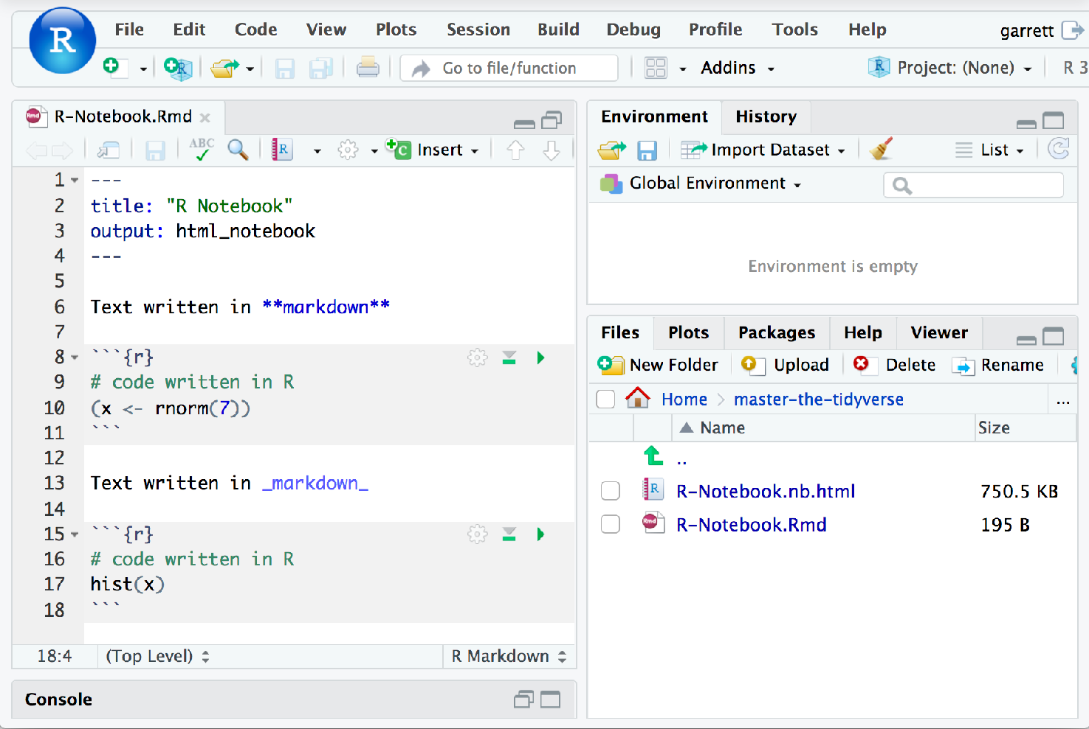
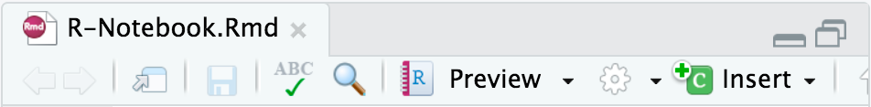
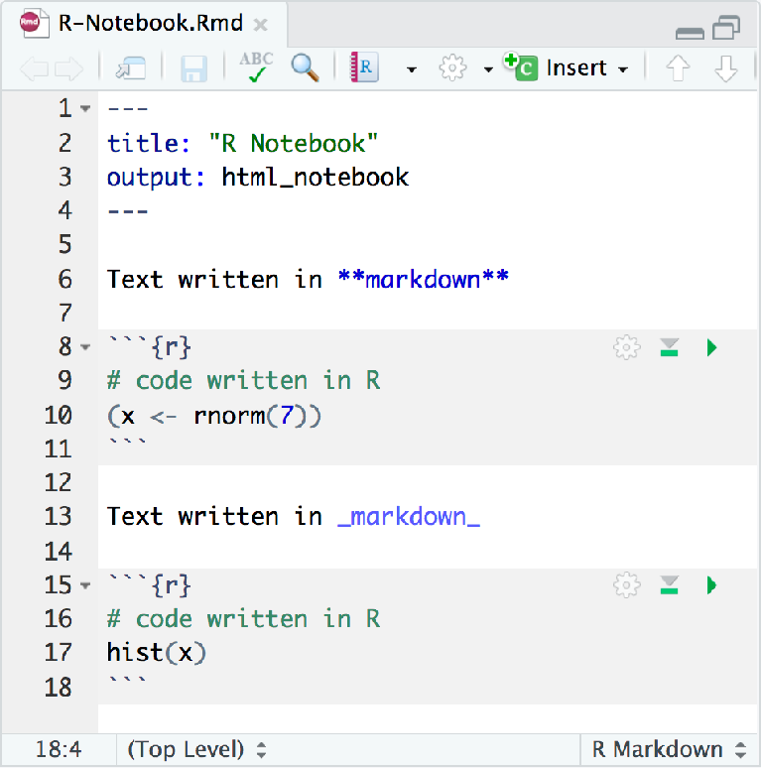
R Markdown
Plain text file with 3 types of content:
A YAML header surrounded by
— — —
Text in markdown
Code chunks surrounded by
```
CC BY-SA RStudio

Slide 5

How it works

Slide 6












knitr
pandoc
Rmd
md
ioslides slidy, Beamer
Powerpoint
Microsoft Word
6
CC BY-SA RStudio

Slide 7
Logistics
1
Knitr runs the document in a fresh R session, which means you need to load the libraries that the document uses in the document
CC BY-SA RStudio

Slide 8
Logistics
1
2
Knitr runs the document in a fresh R session, which means you need to load the libraries that the document uses in the document
Objects made in one code chunk will be available to code in later code chunks.
CC BY-SA RStudio

Slide 9

knitr is multi-lingual!
SAS
python more
9
CC BY-SA RStudio

Slide 10
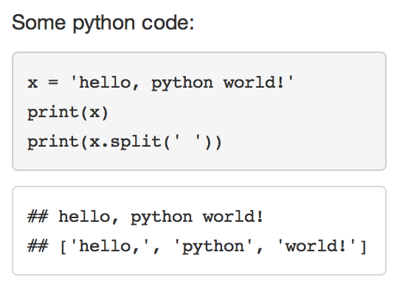
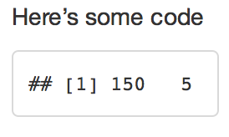
engine
To embed non R code, change the chunk label from r to the language to use.
python
Some python code,
```{python}
x = 'hello, python world!'
print(x) print(x.split(' '))
```
CC BY-SA RStudio

Slide 11

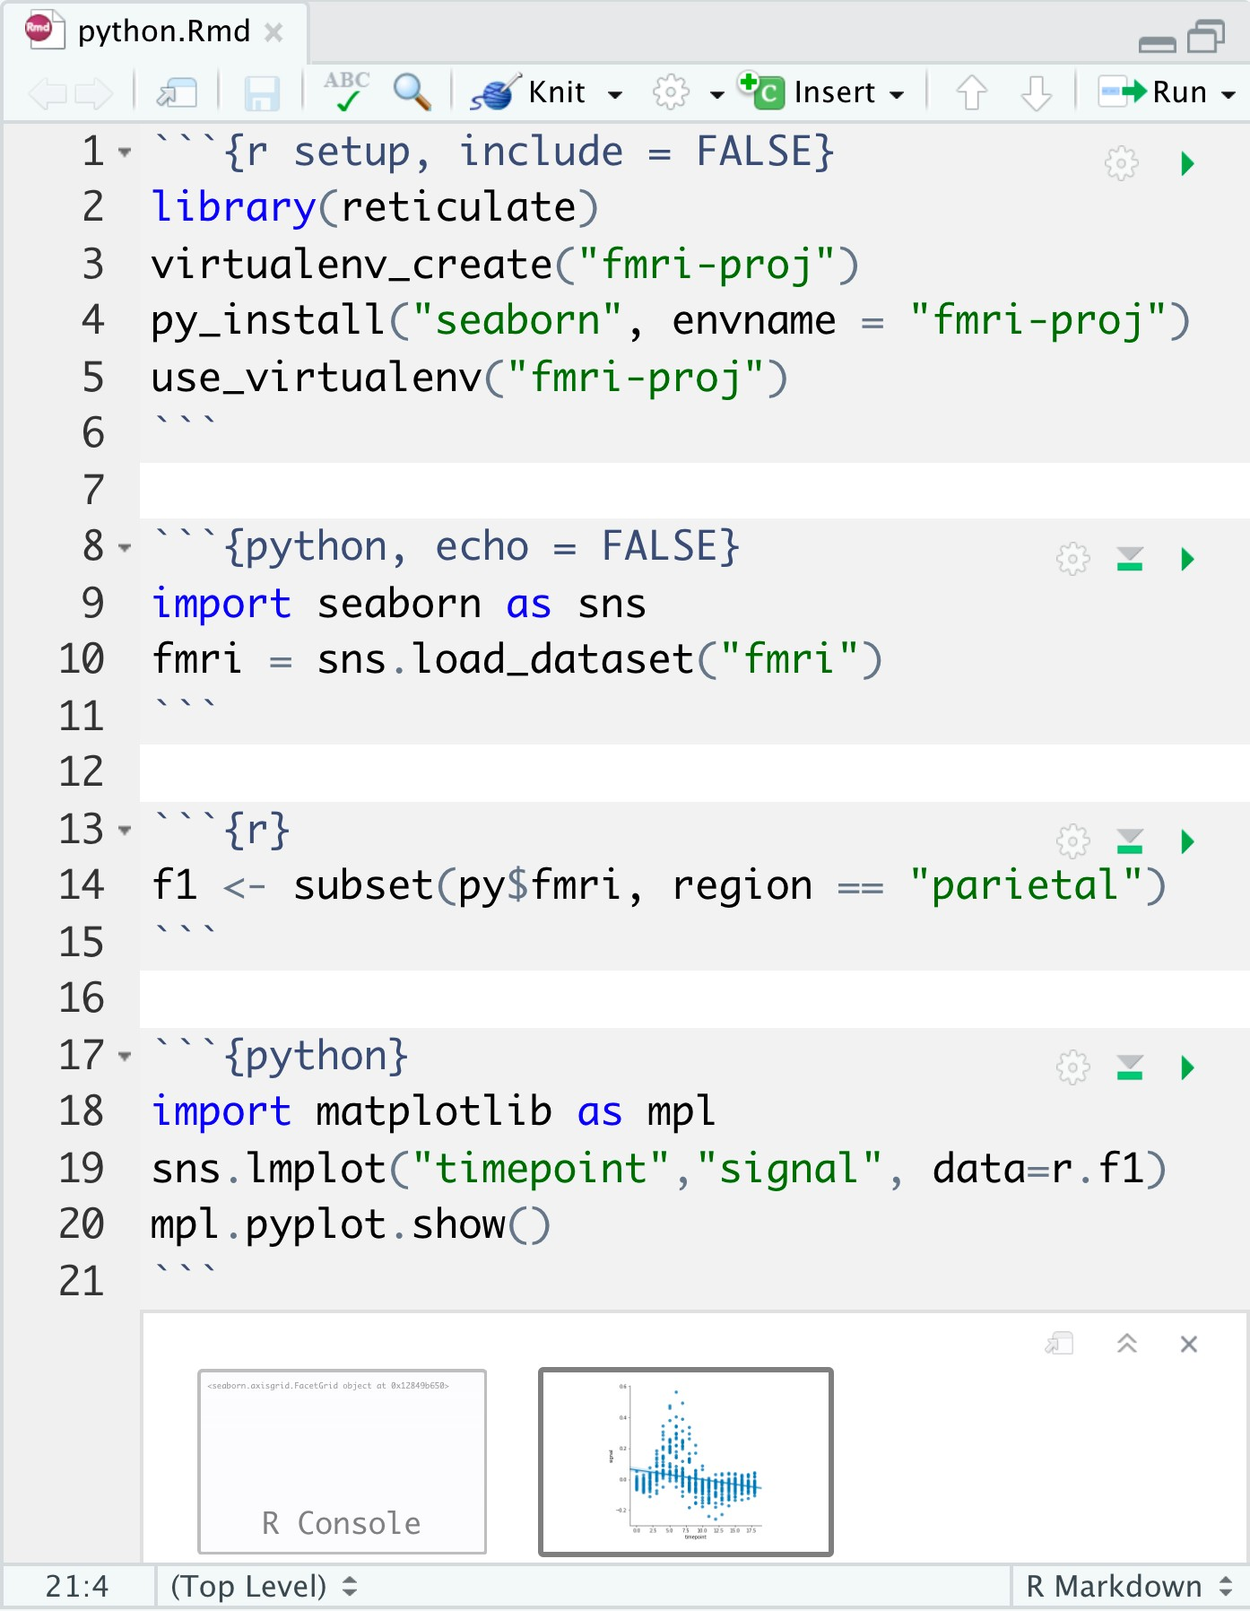
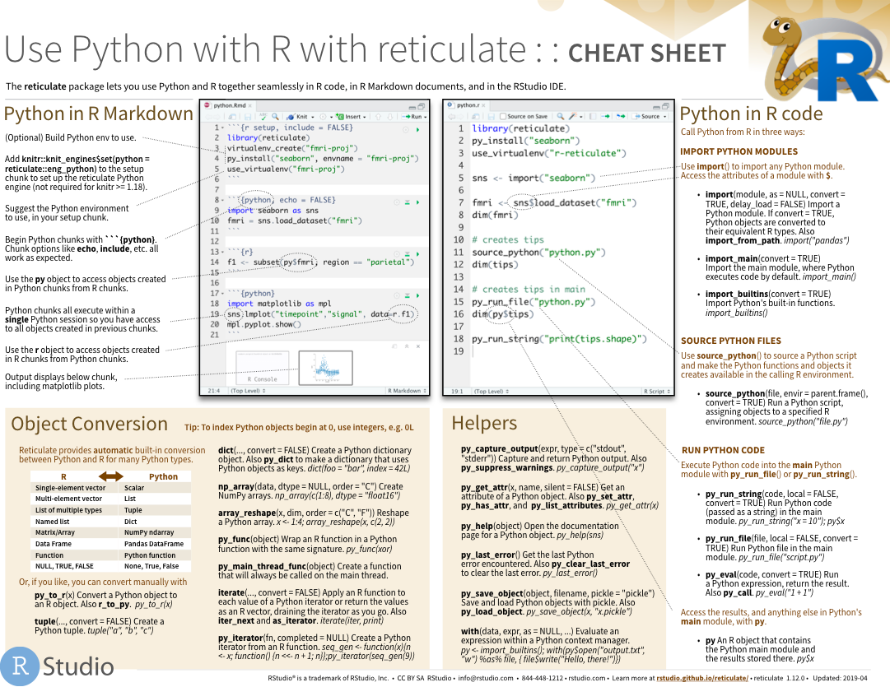
Reticulate
Python in R Markdown
(Optional) Build Python env to use.
Add knitr::knit_engines$set(python = reticulate::eng_python) to the setup chunk to set up the reticulate Python engine (not required for knitr >= 1.18).
Suggest the Python environment to use, in your setup chunk.
Begin Python chunks with ```{python}. Chunk options like echo, include, etc. all work as expected.
Use the py object to access objects created in Python chunks from R chunks.
Python chunks all execute within a single Python session so you have access to all objects created in previous chunks.
Use the r object to access objects created in R chunks from Python chunks.
Output displays below chunk, including matplotlib plots.
A package for using R and Python together.
11

Slide 12

bookdown.org/yihui/rmarkdown/
ONLINE, FREE
12
CC BY-SA RStudio

Slide 13
Markdown
Text in markdown

Slide 14
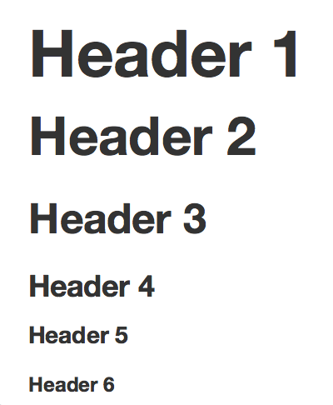
Headers
Use # to create headers.
Multiple #’s create lower level headers.
# Header 1
## Header 2
### Header 3
#### Header 4
##### Header 5
###### Header 6
14
CC BY-SA RStudio

Slide 15

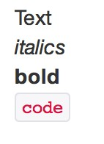
Text
Text is rendered as plain text. Surround text with _, **, or ` to format it.
Add two spaces at the end of a line to start a new line
Text
_italics_
**bold**
`code`
15
CC BY-SA RStudio

Slide 16
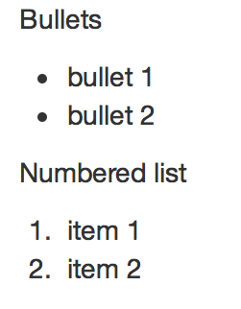
Lists
Use asterisks to make bullet points. Use numbers to make numbered lists.
Bullets
bullet 1
bullet 2
Numbered list
item 1
item 2
16
CC BY-SA RStudio

Slide 17

Hyperlinks
Use brackets to denote a link. Place the URL in parentheses.
This is a [link](www.git.com)
.
17
CC BY-SA RStudio

Slide 18

Images
Use a link preceded by an ! to insert an image.
The link text should be a URL (if the image is hosted online), or a file path (if the image is saved as a file)
![](images/1.png) The RStudio logo.
18
CC BY-SA RStudio

Slide 19
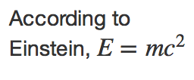
Equations
Write equations with latex math commands and surround them in $’s.
According to Einstein,
$E=mc^{2}$
19
CC BY-SA RStudio

Slide 20
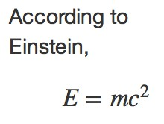
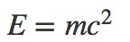
Equation blocks
Use two $’s to make centered equation blocks.
According to Einstein,
$$E=mc^{2}$$
20
CC BY-SA RStudio

Slide 21
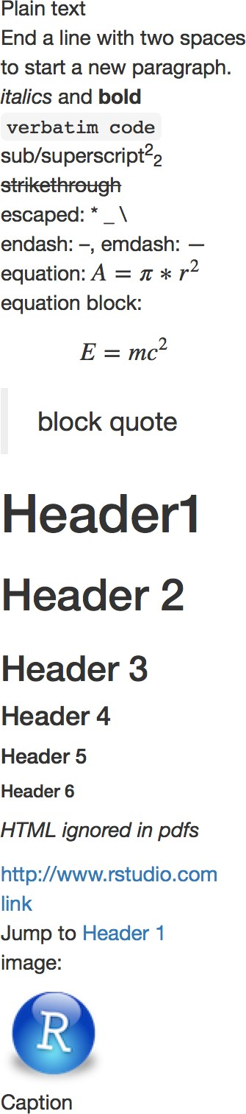







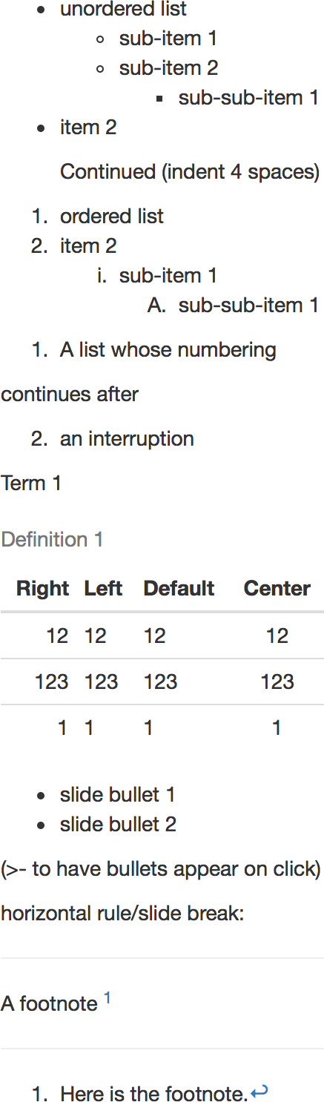

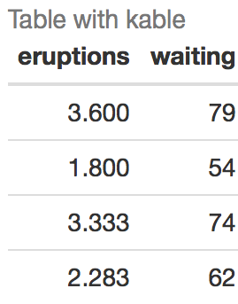
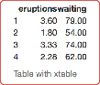
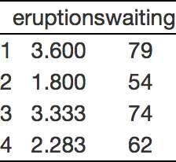
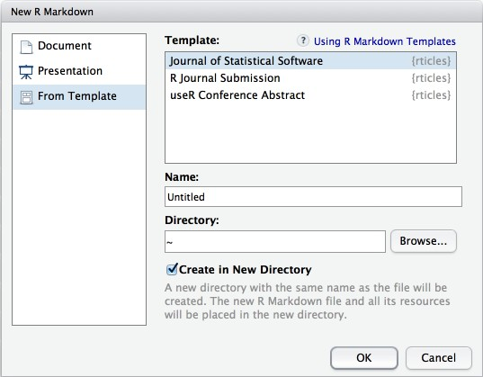
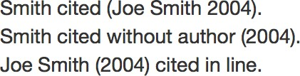

Markdown
Pandoc’s Markdown
Write with syntax on the left to create effect on right (after render)
Plain text
End a line with two spaces to start a new paragraph.
*italics* and **bold**
`verbatim code` sub/superscript^2^~2~
~~strikethrough~~
escaped: \* \_ \\ endash: --, emdash: ---
equation: $A = \pi*r^{2}$
equation block:
$$E = mc^{2}$$
> block quote
# Header1 {#anchor} ## Header 2 {#css_id}
### Header 3 {.css_class} #### Header 4
##### Header 5
###### Header 6
<!--Text comment-->
\textbf{Tex ignored in HTML}
<em>HTML ignored in pdfs</em>
<http://www.rstudio.com> [link](www.rstudio.com) Jump to [Header 1](#anchor) image:
![Caption](smallorb.png)
unordered list
+ sub-item 1
+ sub-item 2
- sub-sub-item 1
item 2
Continued (indent 4 spaces)
ordered list
item 2
sub-item 1
A. sub-sub-item 1
(@) A list whose numbering continues after
(@) an interruption Term 1
: Definition 1
| Right | Left | Default | Center |
|------:|:-----|---------|:------:|
| 12 | 12 | 12 | 12 |
| 123 | 123 | 123 | 123 |
| 1 | 1 | 1 | 1 |
slide bullet 1
slide bullet 2
(>- to have bullets appear on click) horizontal rule/slide break:
***
A footnote [^1]
[^1]: Here is the footnote.
Dictionary of formatting cues.
Pandoc’s Markdown
Write with syntax on the left to create effect on right (after render)
Plain text
End a line with two spaces to start a new paragraph.
*italics* and **bold**
`verbatim code` sub/superscript^2^~2~
~~strikethrough~~ escaped: \* \_ \\ endash: --, emdash: ---
equation: $A = \pi*r^{2}$ equation block:
$$E = mc^{2}$$
> block quote
# Header1 {#anchor} ## Header 2 {#css_id}
### Header 3 {.css_class} #### Header 4
##### Header 5
###### Header 6
<!--Text comment-->
\textbf{Tex ignored in HTML}
<em>HTML ignored in pdfs</em>
<http://www.rstudio.com> [link](www.rstudio.com) Jump to [Header 1](#anchor) image:
![Caption](smallorb.png)
* unordered list
+ sub-item 1
+ sub-item 2
- sub-sub-item 1
* item 2
Continued (indent 4 spaces)
1. ordered list
2. item 2
i) sub-item 1
A. sub-sub-item 1
(@) A list whose numbering continues after
(@) an interruption Term 1
: Definition 1
| Right | Left | Default | Center |
|------:|:-----|---------|:------:|
| 12 | 12 | 12 | 12 |
| 123 | 123 | 123 | 123 |
| 1 | 1 | 1 | 1 |
- slide bullet 1
- slide bullet 2
(>- to have bullets appear on click) horizontal rule/slide break:
***
A footnote [^1]
[^1]: Here is the footnote.
Set render options with YAML
When you render, R Markdown
runs the R code, embeds results and text into .md file with knitr
then converts the .md file into the finished format with pandoc
rmarkdown
sub-option
description
html
pdf word odt rtf md
gituhb
ioslides slidy beamer
Set a document’s default output format
citation_package
The LaTeX package to process citations, natbib, biblatex or none X X X
---
code_folding Let readers to toggle the display of R code, "none", "hide", or "show" X
in the YAML header:
output: html_document
---
# Body
colortheme Beamer color theme to use X
css CSS file to use to style document X X X
dev Graphics device to use for figure output (e.g. "png") X X X X X X X
on back of
output value html_document pdf_document word_document odt_document rtf_document md_document
creates
html
pdf (requires Tex ) Microsoft Word (.docx) OpenDocument Text Rich Text Format Markdown
duration Add a countdown timer (in minutes) to footer of slides X
fig_caption Should figures be rendered with captions? X X X X X X X
fig_height, fig_width Default figure height and width (in inches) for document X X X X X X X X X X
RMarkdown
highlight Syntax highlighting: "tango", "pygments", "kate","zenburn", "textmate" X X X X X
includes File of content to place in document (in_header, before_body, after_body) X X X X X X X X
github_document ioslides_presentation slidy_presentation beamer_presentation
Github compatible markdown ioslides HTML slides
slidy HTML slides
Beamer pdf slides (requires Tex)
incremental Should bullets appear one at a time (on presenter mouse clicks)? X X X
keep_md Save a copy of .md file that contains knitr output X X X X X X
keep_tex Save a copy of .tex file that contains knitr output X X
latex_engine Engine to render latex, "pdflatex", "xelatex", or "lualatex" X X lib_dir Directory of dependency files to use (Bootstrap, MathJax, etc.) X X X mathjax Set to local or a URL to use a local/URL version of MathJax to render equations X X X md_extensions Markdown extensions to add to default definition or R Markdown X X X X X X X X X X number_sections Add section numbering to headers X X
pandoc_args Additional arguments to pass to Pandoc X X X X X X X X X X preserve_yaml Preserve YAML front matter in final document? X reference_docx docx file whose styles should be copied when producing docx output X
self_contained Embed dependencies into the doc X X X slide_level The lowest heading level that defines individual slides X smaller Use the smaller font size in the presentation? X
smart Convert straight quotes to curly, dashes to em-dashes, … to ellipses, etc. X X X template Pandoc template to use when rendering file quarterly_report.html). X X X X X theme Bootswatch or Beamer theme to use for page X X
toc Add a table of contents at start of document X X X X X X X
toc_depth The lowest level of headings to add to table of contents X X X X X X
toc_float Float the table of contents to the left of the main content X
cheat sheet
Indent 2 Indent 4
Customize output with sub-options (listed to the right):
---
spaces spaces
output: html_document: code_folding: hide toc_float: TRUE
---
# Body
html tabsets
Use tablet css class to place sub-headers into tabs
# Tabset {.tabset .tabset-fade .tabset-pills}
## Tab 1
Tabset
Tab 1 Tab 2
text 1
End tabset
text 1
## Tab 2
text 2
### End tabset
Create a Reusable Template
Table Suggestions
Several functions format R data into tables
Citations and Bibliographies
Create citations with .bib, .bibtex, .copac, .enl, .json,
.medline, .mods, .ris, .wos, and .xml files
1. Create a new package with a inst/rmarkdown/templates
directory
In the directory, Place a folder that contains:
template.yaml (see below) skeleton.Rmd (contents of the template) any supporting files
Install the package
Access template in wizard at File ▶ New File ▶ R Markdown template.yaml
Set bibliography file and CSL 1.0 Style file (optional) in the YAML header
Use citation keys in text
---
bibliography: refs.bib csl: style.csl
---
data <- faithful[1:4, ]
```{r results = 'asis'}
knitr::kable(data, caption = "Table with kable”)
```
```{r results = "asis"}
print(xtable::xtable(data, caption = "Table with xtable”), type = "html", html.table.attributes = "border=0"))
```
Smith cited [@smith04].
Smith cited without author [-@smith04]. @smith04 cited in line.
---
name: My Template
—
3. Render. Bibliography will be added to end of document
```{r results = "asis"}
stargazer::stargazer(data, type = "html", title = "Table
with stargazer")
```
Learn more in
the stargazer,
xtable, and knitr
packages.
RStudio® is a trademark of RStudio, Inc. • CC BY SA RStudio • info@rstudio.com • 844-448-1212 • rstudio.com • Learn more at rmarkdown.rstudio.com • rmarkdown 1.6 • Updated: 2016-02
21

Slide 22
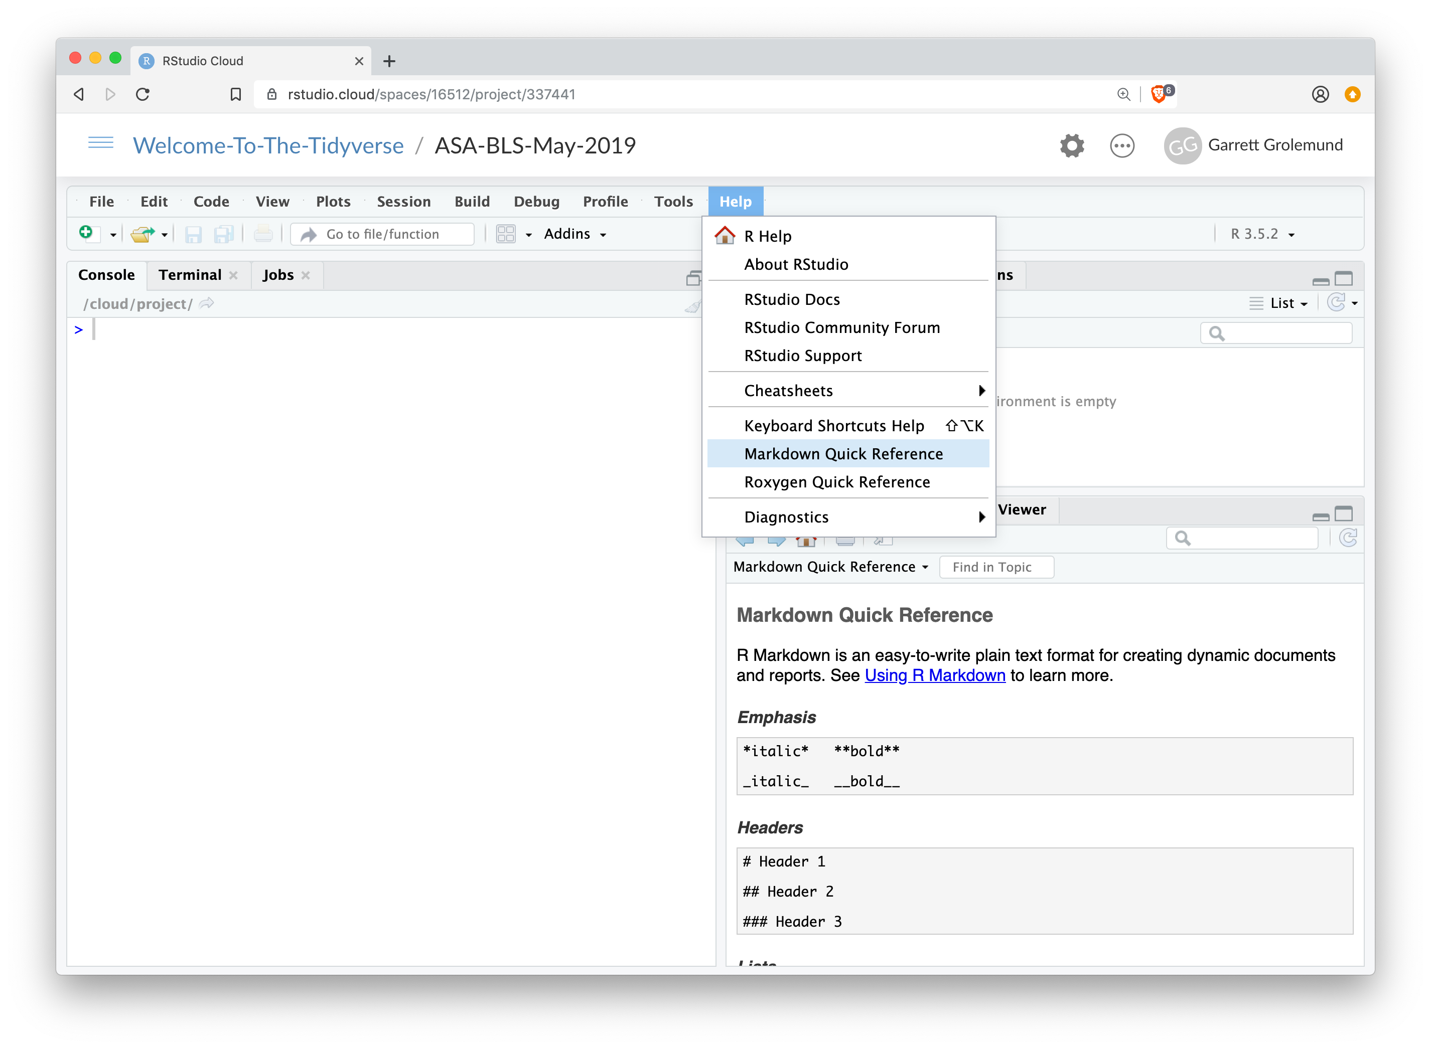
IDE Reference
Go to Help > Markdown Quick Reference
opens
here

Slide 23
Code
Code chunks surrounded by
```

Slide 24
Code chunks
Insert a chunk of R code with
```{r}
# some code
```
When you render the report, R Markdown will run the code and include its results. R Markdown will also remove the ```{r} and ```.
24
CC BY-SA RStudio

Slide 25


Code chunks
Insert a chunk of R code with
```{r}
# some code
```
⌘
Ctrl
+
+
Opt Alt
+
+
i i
(Mac)
(PC)
CC BY-SA RStudio

Slide 26
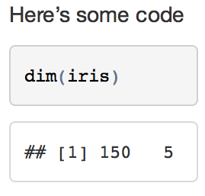
chunk options
By default, R Markdown includes both the code and its results
Here’s some code
```{r} dim(iris)
```
26
CC BY-SA RStudio

Slide 27
echo
Add options in the brackets after r.
echo = FALSE hides the code.
Here’s some code
```{r echo=FALSE dim(iris)
```
}
Very useful
for plots
27
CC BY-SA RStudio

Slide 28
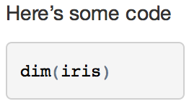
eval
eval = FALSE prevents the code from being run. As a result, no results will be displayed with the code.
Here’s some code
```{r eval=FALSE dim(iris)
```
}
28
CC BY-SA RStudio

Slide 29

include
include = FALSE runs the code, but prevents both the code and the results from appearing (e.g. to setup).
Here’s some code
```{r include=FALSE} dim(iris)
```
29
CC BY-SA RStudio

Slide 30
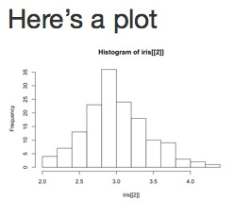
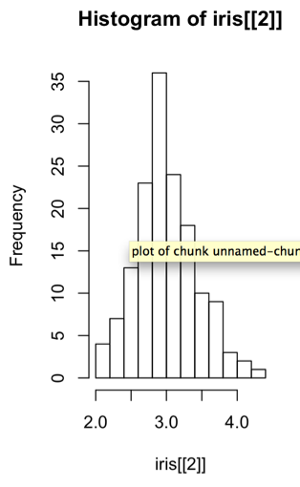
fig.height, fig.width
Specify the dimension of plots (in inches) with fig.width and fig.height. Separate multiple arguments with commas.
Here’s a plot
```{r echo=FALSE, fig.width=3, fig.height=5 hist(iris[[2]])
```
}
30
CC BY-SA RStudio

Slide 31
Pop Quiz
Do you notice the TODOs in
06-RMarkdown-Exercises.Rmd?
Do you notice the long setup chunk?
31
CC BY-SA RStudio

Slide 32
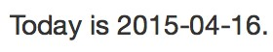
Inline code
Place code in a sentence with `r <code>`. R Markdown will replace the code with its results.
Today is
`r Sys.Date()`.
32
CC BY-SA RStudio

Slide 33
Inline code
Code whose results are inserted into the text.
Today is `r Sys.Date()`.
Surround with `r `
Code to run. Only the result will be included.
33
CC BY-SA RStudio

Slide 34

Your Turn 1
In 06-RMarkdown-Exercises.Rmd:
Replace every Garrett with your name
Replace every TODO with inline R code
Check that the setup chunk is not included with the output
Ensure that only the output of the plot chunk is shown (not the code)
Knit the document
34
CC BY-SA RStudio

Slide 35
YAML
A YAML header surrounded by
— — —

Slide 36
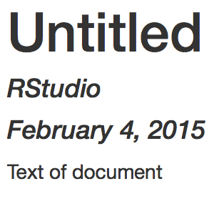
YAML
A section of key:value pairs separated by dashed lines ———
---
title: "Untitled" author: "RStudio"
date: "February 4, 2015" output: html_document
---
Text of document
CC BY-SA RStudio

Slide 37
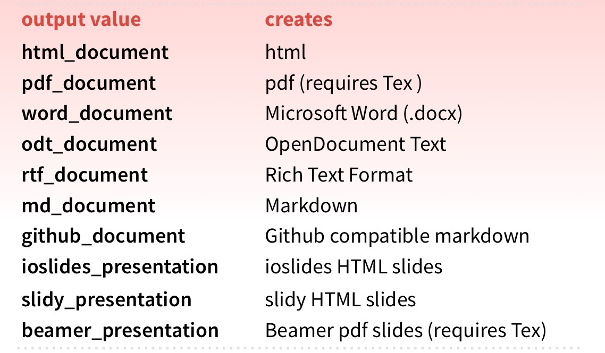
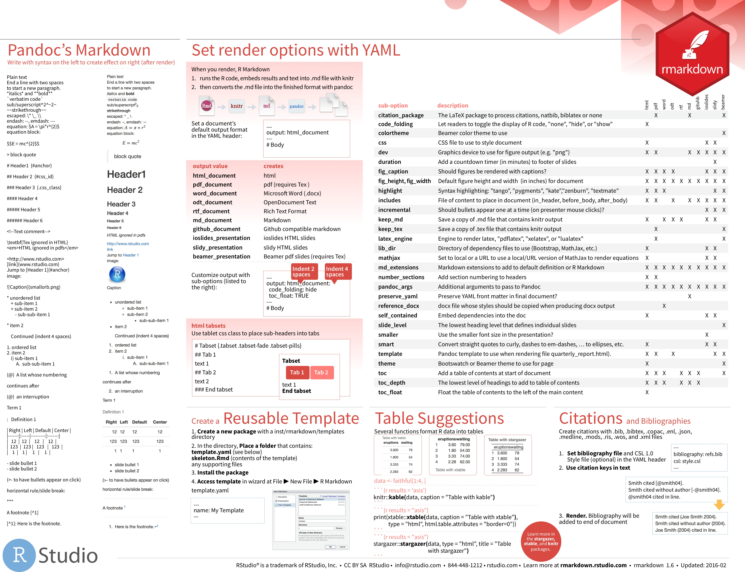
output
The output: field sets the format of the final report
on
back
More at rmarkdown.rstudio.com/formats.html
CC BY-SA RStudio

Slide 38
Parameters

Slide 39

Your Turn 2
Open 05-RMarkdown-Parameters.Rmd.
Click the dropdown menu next to Knit and use Knit with Parameters to render the document.
What happens if you type in a diﬀerent name?
39
CC BY-SA RStudio

Slide 40
Parameters
A list of values that you can call in R code chunks
---
title: "Untitled" output: html_document params:
filename: "data.csv" symbol: "FB"
---
colon
New line.
Indented two spaces
params list
elements and values
40
CC BY-SA RStudio

Slide 41
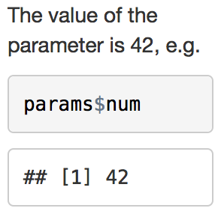
Using Parameters
Call parameter values as elements of the params list, params$num
---
params: num: 42
---
The value of the parameter is
`r params$num`, e.g.
```{r} params$num
```
41
CC BY-SA RStudio

Slide 42
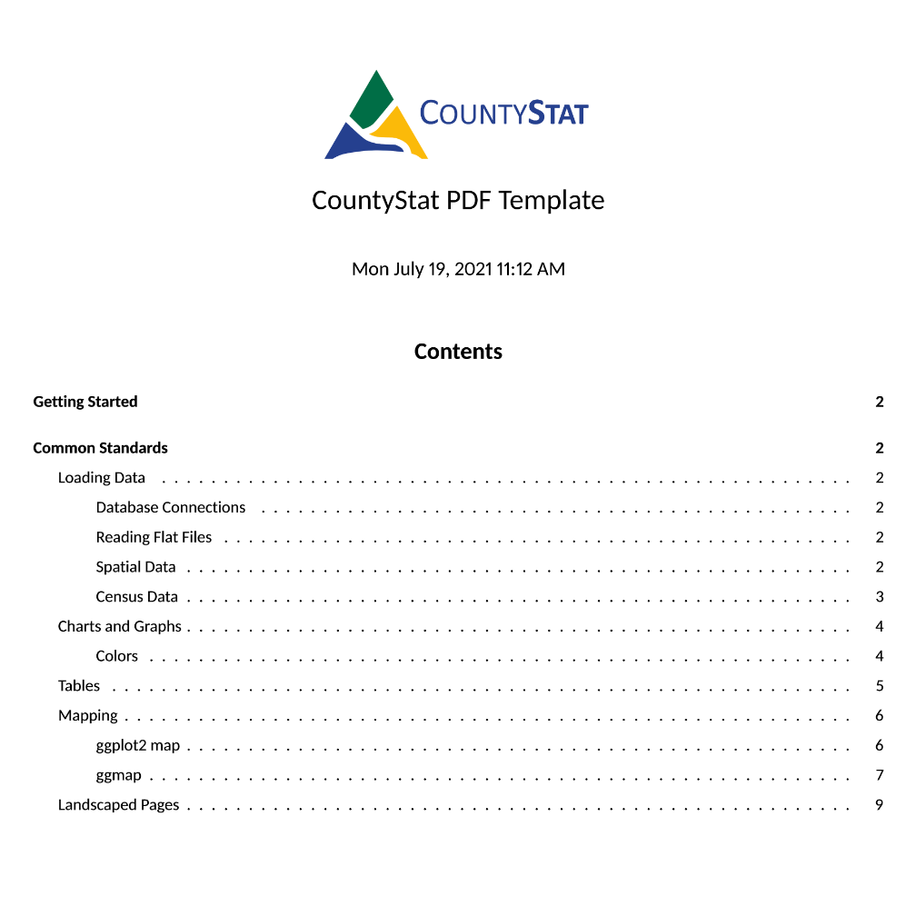
CountyStat Templates
github.com/Allegheny-CountyStats/CountyStat-Templates

Slide 43
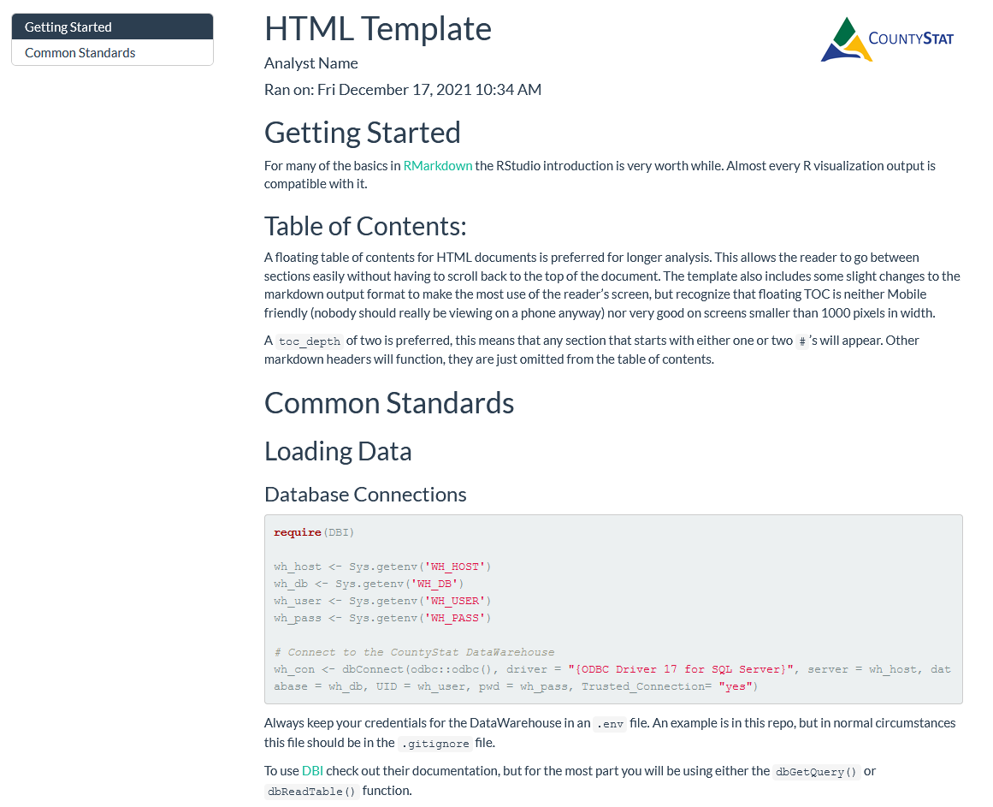
CountyStat Templates
github.com/Allegheny-CountyStats/CountyStat-Templates

Slide 44
Report Reproducibly with
Slides CC BY-SA RStudio

Slide 45


Import

Slide 46
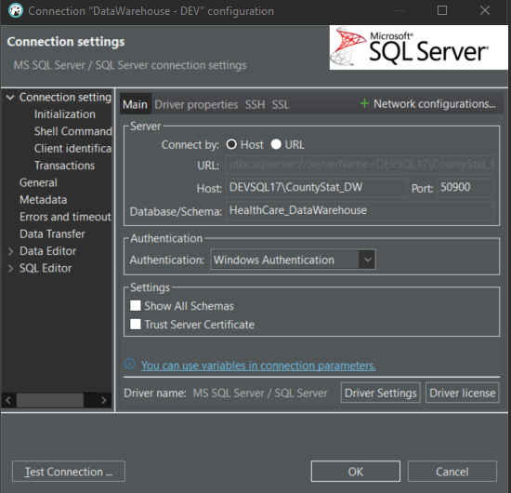
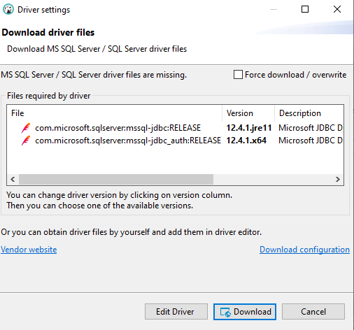
Finding DIT example(s)
Open DBeaver
Click Database in the top right
Select New Database Connection
Fill out these connection settings
Click the “Test Connection” button
Click Download on the Driver Settings page
Who succeeds?

Slide 47
Thank you
43
CC BY-SA RStudio

